Slide 1
An introduction to Amazon AI
Julien Simon
Principal Technical Evangelist, AWS
@julsimon
Notes:
1,5 min.
Welcome. Thank you for joining this presentation about Amazon Polly. My name is Rafal Kuklinski and I am a manager of the Amazon Text-to-Speech team and at the same time I am leading the Amazon Development Center in Poland.
My background is software development. Prior to Amazon I held technical and leadership positions and worked on algorithms for flight planning systems and video analysis.
And then I joined Amazon. For the last 5 years I have been working on speech synthesis systems that power a wide range of Amazon products and services, including Amazon Fire tablets, Amazon Kindle Readers and Amazon Alexa. I work on the application of Machine Learning and signal processing in the speech synthesis domain.
Today we introduce Amazon Polly: a Text-to-Speech service that turns text into lifelike speech. So let me share some more information on what to expect from this session.

Slide 2
Artificial Intelligence At Amazon
Thousands Of Employees Across The Company Focused on AI
Discovery &
Search
Enhance
Existing Products
Define New
Categories Of
Products
Bring Machine
Learning To All
Fulfilment &
Logistics

Slide 4
Amazon AI: Three New Deep Learning Services
Lex
Polly
Rekognition
Conversational
Engine
Life-like Speech
Image Analysis

Slide 5
Amazon Lex

Slide 6
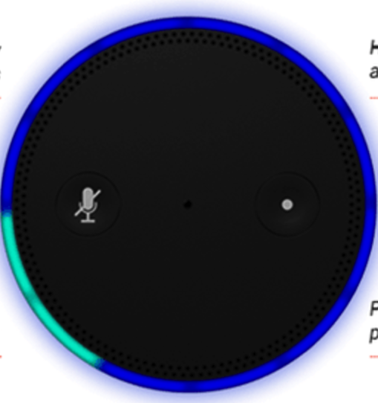
Text and Speech Language Understanding
Speech
Recognition
Natural Language
Understanding
Powered by the same Deep Learning technology as Alexa

Slide 7
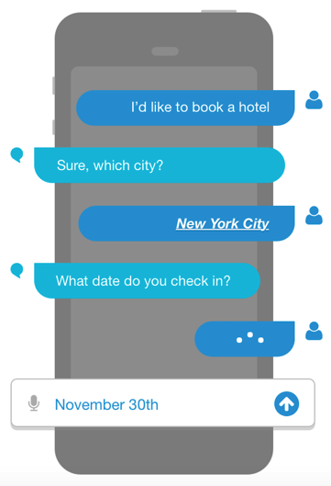
Lex Bot Structure
Intents
An Intent performs an action in response to natural language user input
BookHotel
Utterances
Spoken or typed phrases that invoke your intent
Slots
Slots are input data required to fulfill the intent
Fulfillment
Fulfillment mechanism for your intent

Slide 8
Amazon Polly

Slide 9
Amazon Polly
A service that converts text into lifelike speech
Offers 47 lifelike voices across 24 languages
Low latency responses enable developers to build real-time systems
Developers can store, replay and distribute generated speech
Notes:
5 min.
It’s a services that converts text to lifelike speech.
It is fully managed and continuously improved: You don’t have to worry about updating your TTS on-device. Any time you refer to Polly you will get the most accurate and natural speech.
Polly can speak in 24 languages and offers a variety of 47 voices.
Low latency responses enable developers to build real-time solutions like conversational systems

Slide 10
Amazon Polly: Language Portfolio
EMEA:
British English
Danish
Dutch
French
German
Icelandic
Italian
Norwegian
Polish
Portuguese
Romanian
Russian
Spanish
Swedish
Turkish
Welsh
Welsh English
Americas:
Brazilian Portuguese
Canadian French
English (US)
Spanish (US)
APAC:
Australian English
Indian English
Japanese
Notes:
10min.
On this slide we present the 24 languages offered by Amazon Polly. Regions marked with orange on this map are regions where one of our languages is commonly used so those are regions where you can deliver your app using Amazon Polly.

Slide 11
Amazon Rekognition

Slide 12
Amazon Rekognition
Deep learning-based image recognition service
Search, verify, and organize millions of images
Object and Scene
Detection
Facial
Analysis
Face
Comparison
Facial
Recognition
Notes:
Introducing Amazon Rekognition - a fully managed deep learning based image recognition service. Rekognition was designed from the get-go to run at scale. It comprehends scenes, objects, concepts and faces. Given an image, it will return a list of labels. Given an image with one or more faces,it will return bounding boxes for each face, along with face attributes. Given two images with faces, it will compare the largest face from the source image and find similarity with faces found in the tagret image. Rekognition provides quality face recognition at scale, and supports creation of collection of millions of faces and search of similar faces in the collection.
Now lets dive into each of these features and look at the API that support these features.

Slide 13
Apache MXNet
Programmable
Portable
High Performance
Simple syntax,
multiple languages
Highly efficient
models for mobile
and IoT
Near linear scaling
across hundreds of GPUs
Most Open
Best On AWS
Accepted into the
Apache Incubator
Optimized for
Deep Learning on AWS

Slide 14
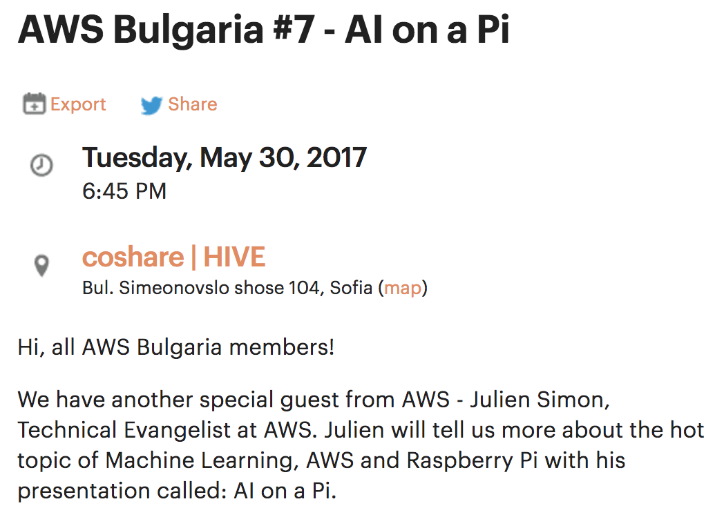
https://www.meetup.com/AWS-Bulgaria/

Slide 15
благодаря !
Julien Simon
Principal Technical Evangelist, AWS
@julsimon

