Slide 1
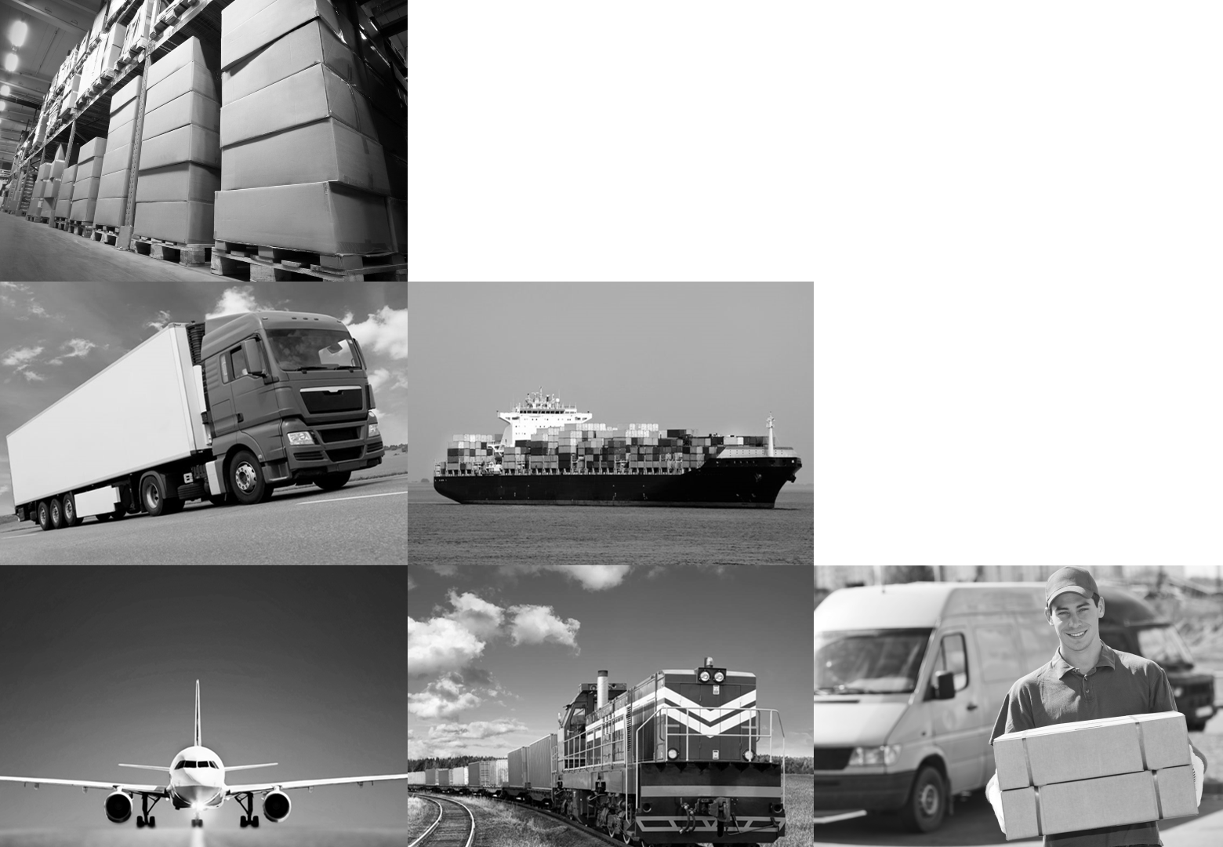

Next Generation cargo ERP
    Enterprise
    Resource
    Prediction
Big Data Predictive analytics for cargo transport optimization

Slide 2
Which analytics?
Prescriptive
Predictive
Descriptive
What’s should we do?
Optimization
Decision trees
What’s gonna happen?
Forecasting
Simulations
What's going on?
Dashboards
BI
Source: http://danalytix.blogspot.bg/2013/01/business-analytics-defined.html

Slide 3
Why is it so hard?
Big data / predictive analytics capabilities
Own funding to build software tools
Big data ecosystem access
Software development capabilities
Predictive models
Software product design skills
Mathematical optimization skills
Dedicated IT team
Statistics knowledge
Project
manage-ment
Software
UX skills
Cargo transport domain knowledge
Cargo transport domain knowledge
Knowledge of 40 different transport business models
Skills in optimization of transport flows
Good network of contacts in transport
Cargo transport data knowledge
Knowledge of profit management in transport

Slide 4
Discussion
Challenges
Business - IT alignment x2 (+ Data Science)
Difficult to find/motivate data scientists
As DW projects but worse (think communication, coordination, etc.)
Difficult to communicate DS to business and industry concepts to mathematicians
Very high risk of not realizing business benefits
Ideas
It’s non-trivial – and you need scale
Grow internally or outsource?
For customers: choose a partner who
  Is invested in the final benefits (having a success fee is good sign)
  Deeply understands your business
For service providers
  There’s an immense opportunity
  You need to focus
Notes:
We talked to a lot of companies with data science departments

Slide 5
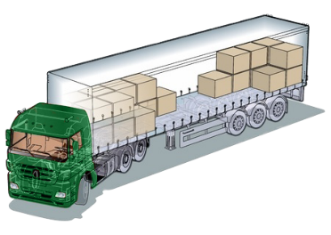
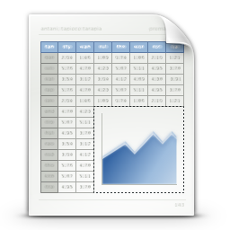




How Transmetrics product works
Transmetrics
Load Factor Module
Transmetrics
Forecasting
Module
Historical load factors
+ machine learning
(orders, tons, scans, linehauls, routing)
Demand Forecast
(# orders, tons from
pickup to delivery)
TMS
(orders, tons, scans, linehauls, routing)
Transmetrics
Optimization
Module
Transmetrics
Execution
Module
Linehaul plan
(linehaul – tours, schedule, stops)
Supplier management
(Internal and external suppliers)

Slide 6
Thank you for your attention!
http://transmetrics.eu

